Slide 1

AL-FARABI KAZAKH NATIONAL UNIVERSITY
Department of political science and political technologies
Political conflict studies
Abzhapparova AA
Senior lecturer

Slide 2
Political conflict studies
Lecture 14
Negotiations as a technology for managing political conflicts.

Slide 3

Definition negotiations
Negotiations are a means,
the relationship between people,
designed to reach an agreement when both parties have either competing or overlapping interests .

Slide 4
Definition negotiations
An ancient and universal means of resolving conflicts of various types by people:
from interpersonal to interstate .
They allow finding agreement where interests do not coincide, opinions, positions or views of the parties differ significantly
A means of avoiding open conflict, finding an optimal solution to the problem that is mutually acceptable to all parties

Slide 5
Definition of diplomacy in the modern world
Diplomacy - science and art
conducting international relations through negotiations;
a peaceful way in which
this relationship
are regulated and maintained
heads of state, government and special bodies
external relations

Slide 6
Diplomacy in Ancient Times
GREECE | BYZANTIUM
ROME | FRANCE

Slide 7
Diplomacy in Ancient Greece
It contributed a lot to the subsequent methodology of external relations. It had an overly democratic, open, public character. Diplomacy has always been openly associated with deception.

Slide 8
Diplomacy in Ancient Rome
Using force against a weaker opponent A method of stirring up discord between neighbors The principle of "divide and conquer"

Slide 9
Diplomacy in Ancient Byzantium
took experience in conducting diplomacy as in Ancient Greece and Rome Diplomacy has always been openly associated with deception. Using force against a weaker opponent A method of stirring up discord between neighbors The principle of "divide and conquer"

Slide 10
Diplomacy in Ancient France
starting with F. Callier, gradually began to accept more moral forms of conflict resolution, relying on constructive negotiations

Slide 11
Research on Diplomacy in Russia
Main periods :
The manifestation of interest in the problems of the negotiation process and the appearance of the first works on this topic in Russian (1940s–1960s ) ;
The beginning of the development of domestic research on negotiations (1970s–1980s ) ;
The heyday of research on negotiations (late 1980s – second half of the 1990s ) ;
Decline in interest in the problems of negotiation (second half of the 90s – end of the 20th century).
Gradual revival

Slide 12
The first domestic work on the problem of negotiations
The first original work by domestic scholars on the problem of negotiations was a historical essay on the participation of the leader of the Communist Party of China Mao Zedong in peace negotiations with the Kuomintang, “Chongqing Negotiations,” published in 1945.

Slide 13
Modern definition of negotiation
Form of behavior in conflict,
in which its parties seek a way to reduce the divergence of interests
through some kind of interaction between the parties to the conflict"

Slide 14
Negotiations as one of the types of creating and maintaining dialogue with business partners can be conducted with the aim of:
establishing business relationships;
clarification of the positions of the parties on one or more issues;
exchange of information;
settlement of relations;
deepening mutual understanding;
reaching new agreements;
signing of agreements.

Slide 15
IN The partnership approach to negotiations is based on
Constructive dialogue,
Searching for joint solutions to the problem,
Erasing contradictions,
joint analysis of solution options,
The desire and ability to see the problem through the eyes of the other side.
Implementation.

Slide 16
Substantive preparation of negotiations includes addressing the following issues
Problem analysis and situation diagnostics
Formation of a common approach, main goals and objectives
Determining the negotiating position, possible options for solving the problem and
Coordination of interests, formation of proposals and their argumentation .

Slide 17
Classification of negotiations

Slide 18
1 . Classification of negotiations
1. Depending on the area of the affected relations, negotiations are:
● international
● internal (intrastate)
2. From the variety of subjects of the negotiation process:
● interpersonal (face-to-face, one-on-one negotiations)
● intergroup
3. From the variety of subjects of the negotiation process:
● negotiations in conflict situations
● game conditions
● terms of cooperation

Slide 19
2. Classification of negotiations
Classification based on the degree of interest of the parties in reaching an agreement :
● the state shows an indifferent attitude towards reaching agreements or, moreover, seeks to prevent them
● the state strives to achieve positive results, but does not show any particular zeal in doing so
● negotiations that are extremely important for their participants.

Slide 20
3. Classification negotiations
Classification depending on the goals set by the participants. He distinguishes such negotiations as:
● Negotiations aimed at continuing existing agreements, extending previously reached agreements
● Negotiations with the aim of normalizing relations.
● Negotiations to achieve redistributive agreements
● Negotiations to reach new agreements
● Negotiations aimed at obtaining side effects that are not reflected in the agreement

Slide 21
Method of principled negotiations
Authors Roger Fisher, William Ury :
The method of principled negotiations,
consisting of solving problems
based on their qualitative properties,
and not to haggle over what
what each side can or cannot agree to.
The principled negotiation method means
a tough approach to the merits of the case,
but provides for a soft approach
to the relationship between the negotiating parties

Slide 22
Negotiations: the importance of the collective factor
The collective factor is strong when:
Negotiators have little freedom to define their positions.
The negotiator feels responsible to the group.
Only the negotiator himself is responsible for the result.
The negotiator feels a responsibility to the voters who are in the negotiating situation.
The negotiator is appointed than when he is elected

Slide 23
Possible outcomes of negotiations
There are four possible outcomes of negotiations.
apathy
collusion
compromise
conflict

Slide 24
Approaches to Negotiation
• negotiation as the use of a set of tactical rules that provide for a variety of different actions and prohibitions that must be ordered and classified
• negotiating as a manipulation of multiple dilemmas
• negotiation as a process with a structure in time
• negotiation as a complex of different types of activities

Slide 25
Types of activities in negotiation
1) achieving the desired results
2) impact on the power balance
3) creation of a constructive psychological environment
4) application of flexible tactics

Slide 26
Classification of international negotiations

Slide 27
Definition of international negotiations
International negotiations - a method of peacefully resolving differences and settling conflicts between states and other subjects of international relations through discussion and convergence of positions, compromises, and the search for mutually acceptable solutions

Slide 28
Classifications by "procedural" parameters
1 | The level of their management | Expert, heads of state, etc.
2 | The number of parties involved in the negotiation process | Double-sided, multilateral
3 | The nature of interaction between participants | Straight, conducted with the assistance of third parties
4 | Frequency of meetings of participants | Disposable, renewing
5 | The nature of the event | Official or unofficial

Slide 29
Classification on formal grounds
- number and geography of participants
- the degree of regularity of the implementation
- level of management

Slide 30
Classification by substantive grounds
• informational (the parties are interested in exchanging views, but are not ready for some reason to take joint action);
• communicative (establishing new connections, relationships);
• regulatory (regulation and coordination of actions of the parties);
• the function of solving one’s own problems (for example, personal, domestic political, foreign policy, etc.);
• propaganda (allows one of the parties to present itself in a favorable light in the eyes of the public);
• control function (for example, regarding the implementation of agreements

Slide 31
Interpersonal Negotiations

Slide 32
Definition of Interpersonal Negotiations
Interpersonal Negotiations - a way to peacefully resolve differences and settle conflicts between two people by discussing the problem together and finding mutually acceptable solutions

Slide 33
Classification of interpersonal negotiations
    1. Business conversation
    2. Conversation
    3. Discussion and interview
    4. Dispute, controversy, discussion
    5. Bidding

Slide 34
Discussion and interview
Discussion Models
"Brainstorming"
team business game
"Round table"

Slide 35
Definition of the dispute
Dispute are considering as a procedure in which one proves that some idea is true, and the other that it is wrong

Slide 36
Structure and features of the dispute
1. The difference in the positions of the parties, expressed in opinions on the controversial situation, makes the dispute a discussion at the level of phenomenon, and not at the level of essence.
2. The theses of the parties contradict each other in a contradictory form. Thus, if subject "A" asserts the position "a is b", then his opponent in the dispute asserts either "it is not true that a is b" or "a is not b".
3. The struggle of opinions in a dispute reaches its highest form - a conflict or war of opinions, the peculiarity of which is the proof by each side of the truth of its thesis and the falsity of the opponent's thesis.
4. The field of argumentation, as well as the subject field of negotiations, is usually not clearly defined. Its vagueness is also due to the fact that we are not talking about the essence, but about the phenomenon, and the struggle is conducted not by reasons, but by opinions.

Slide 37
Definition of discussion
Discussion (from Latin discussio - I investigate) - one of the varieties of forms of conducting negotiations, a method of argumentation in them, providing for a comprehensive discussion of the subject of disagreement based on establishing the degree of truth and falsity of each thesis put forward by their participants

Slide 38
Main features of the discussion
1. The subject structure is outwardly the same as in a dispute, but its objects are represented not by the communicator and the addressee, but by the opponent and the proponent, co-authors in a collective discussion of a controversial issue.
2. Discussion is characterized as a form of discussion of a subject at the level of essence .
3. The field of argumentation of the discussion, and therefore the subject field of the negotiations, develops under the influence of the process of exchanging opinions as the subject of disagreement becomes clearer.

Slide 39
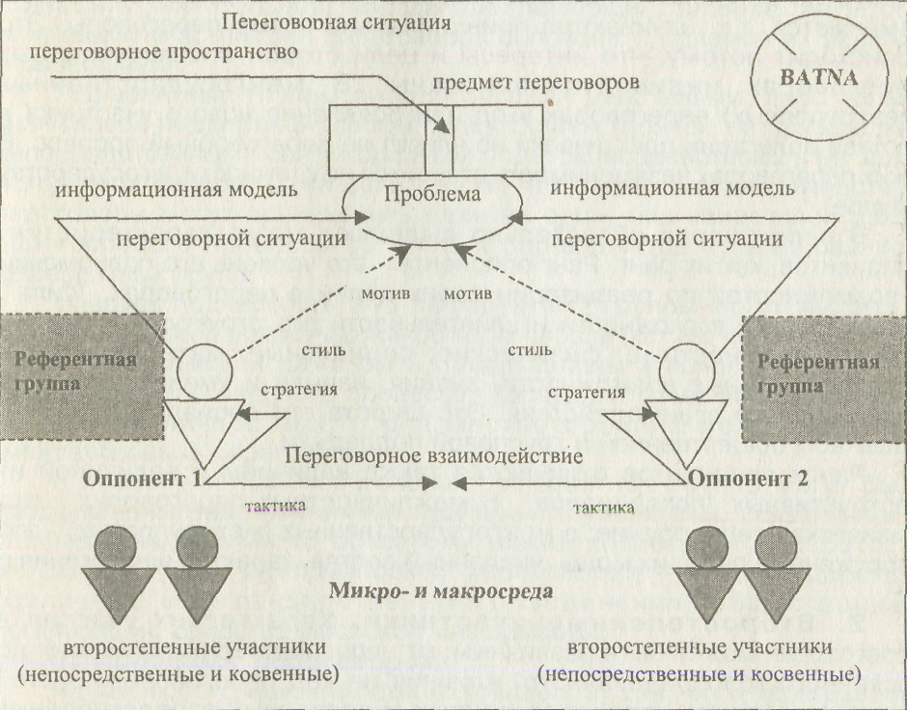
Structure of negotiations

Slide 40
Techniques and tactics in negotiations ( argumentation and counter-argumentation )

Slide 41
Definition of argumentation and counterargumentation
Argumentation (from Latin argumentatio - judgment) - is a way of convincing an opponent (including during negotiations) through significant logical arguments
Counterargument - a way of convincing an opponent

Slide 42
Methods of argumentation
Fundamental method
Method of contradiction
Method of extracting conclusions
Comparison method
The "yes... but" method.
The "boomerang" method
The ignoring method.
Visible support method

Slide 43
Argumentation tactics
Selecting an argumentation technique
Resolving Contradictions
Two-sided argumentation
The order in which the advantages and disadvantages are listed.
Personification of argumentation

Slide 44
Definition of mediation
Definition of mediation
Mediation - a special type of activity consisting of the participation of a third party in the preparation and/or conduct of negotiations in order to optimize the process of finding a mutually acceptable solution.
Mediation - a special type of activity consisting of the participation of a third party in the preparation and/or conduct of negotiations in order to optimize the process of finding a mutually acceptable solution.

Slide 45
Forms of mediation
Mediation as a form of personal participation of a third party in the negotiation process (as a secondary or, less often, primary participant)
2. Mediation as an independent method (means) of political conflict resolution, along with negotiations, which does not require the obligatory personal participation of the mediator in the actual negotiation process

Slide 46
The main stages of mediation
• initiation of the search for consent
• establishing the negotiation process
• participation in the negotiation process
• monitoring the implementation of agreements

Slide 47
Definition of armed conflict
Armed conflict – combat action of a limited contingent of armed forces or specially formed armed units, as well as peacekeeping missions with certain limitations on political goals, scale and time.

Slide 48
The analysis of the results of business negotiations should take place in the following three directions:
1. Analysis immediately after the negotiations - such analysis helps to evaluate the progress and results of the negotiations, exchange impressions and determine priority activities related to the results of the negotiations
2. Analysis at the highest level of the organization’s management – discussion of the report on the results of the negotiations and identification of deviations from previously established directives;
3. Individual analysis of business negotiations is the clarification of the responsible attitude of each participant to their tasks and the organization as a whole. This is a critical self-analysis in the sense of control and learning from negotiations.

